Slide 1


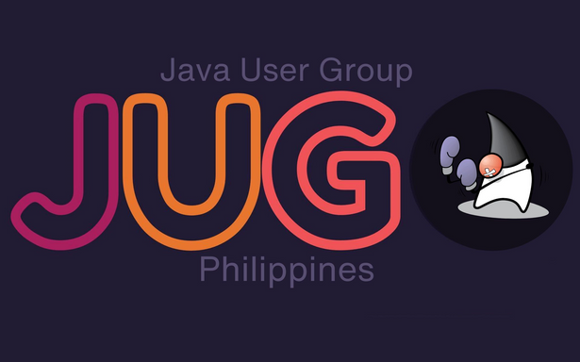

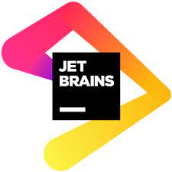
Developing LLM-Driven Java Applications with Langchain4j
by Jansen Ang

Slide 2
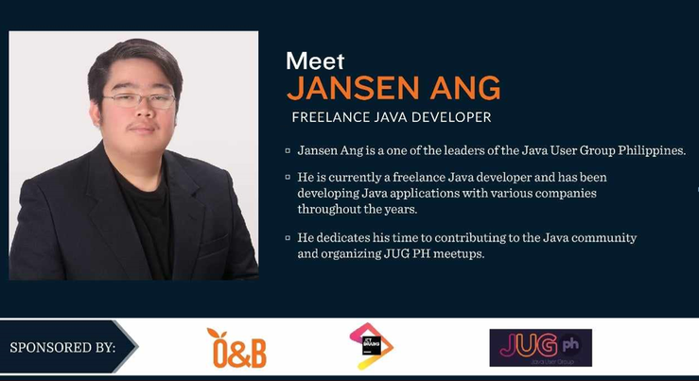


https://www.linkedin.com/in/jansen-ang/
https://github.com/jmgang

Slide 3

Roadmap
01 | Langchain, Langchain4j and its Rise
02 | Components of Langchain4j Concepts Use-Cases
03 | Other and Future features

Slide 4
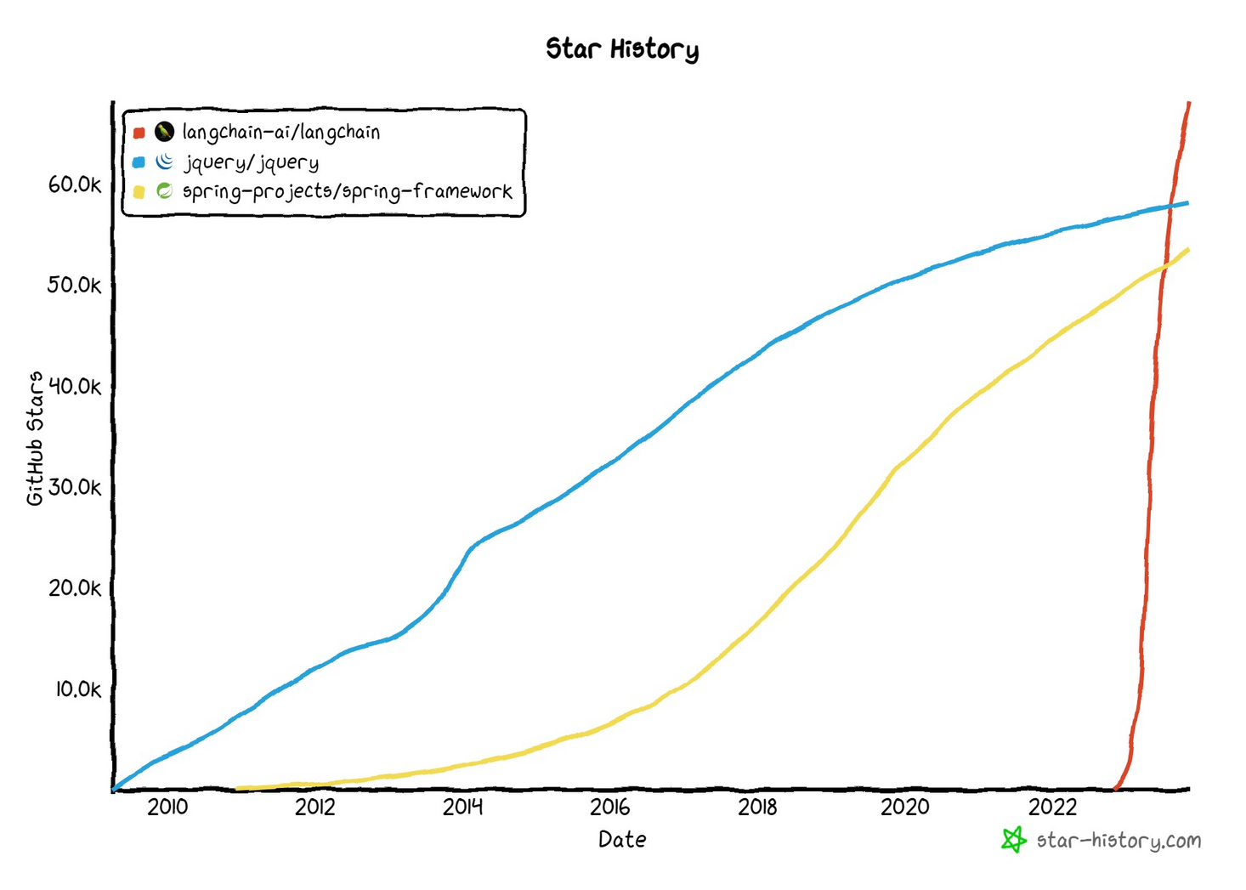
Langchain has achieved more stars in less than a year compared to other popular frameworks

Slide 5
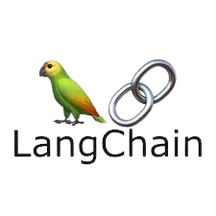



Open-source framework designed for developers to integrate large language models for application development
Simplifies the process of creating Generative AI application interfaces Q&A over documents, analyzing structured data, interacting with apis, code understanding, agents, chatbots, code writing, extraction, summarization, etc. Currently only supports Python and JS/TS

Slide 6

Langchain4j
Java version of
Langchain, created by the Java community
Has the same capability with Langchain but with additional and powerful features

Slide 7
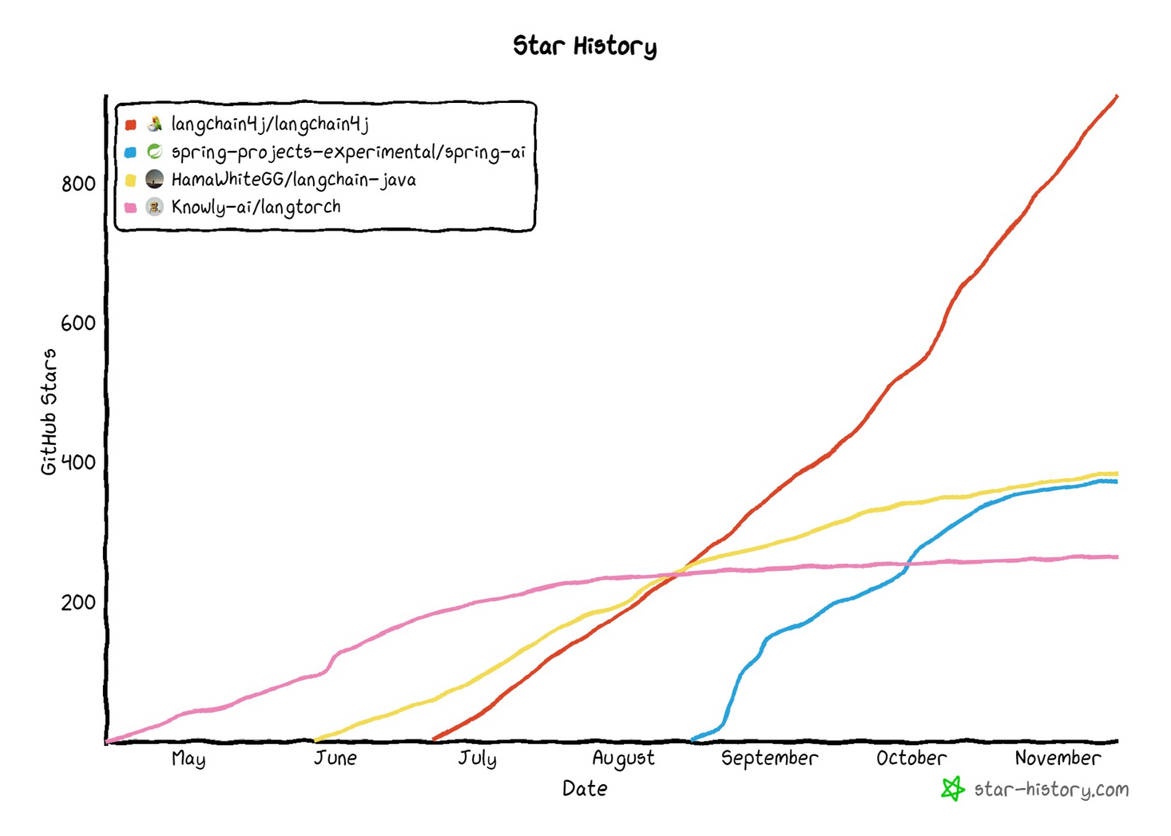
Langchain4j is currently the leading standalone Java-based LLM framework on GitHub, as measured by the number of stars.

Slide 8
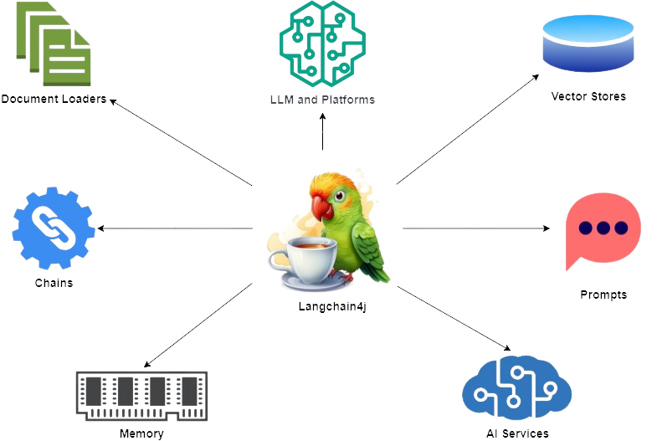
Components of Langchain4j

Slide 9
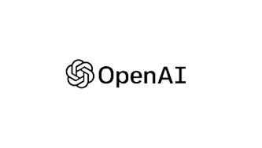
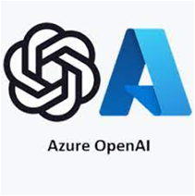





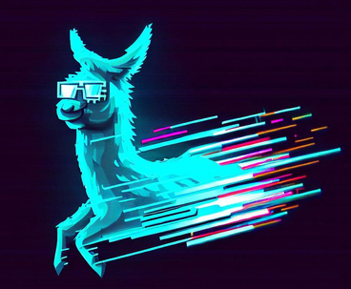
LLMs and Platforms
Core component of Langchain4j
Provides a standard interface for interacting with many different LLMs and LLM providers
LocalAI
Ollama

Slide 10


Prompts
Act as the input or instruction that guides the model to generate a specific output or perform a particular task
Supports application of user-input variables
Supports annotations such as @UserMessage, @SystemMessage and @StructuredPrompt
What are the features of
Java version {{version}}?

Slide 11

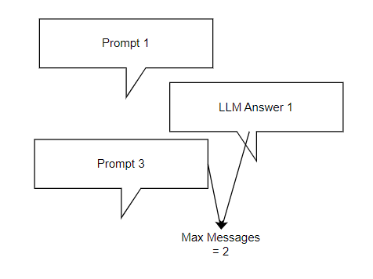
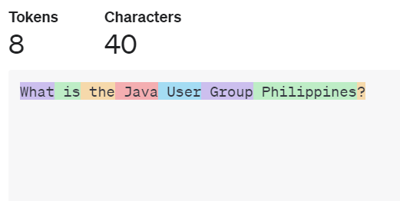
Memory
Storage for previous prompts and responses
Can be In-Memory or Persistent
Message-Window based
Token-Window based

Slide 12

Chains
Reduces the need for extensive boilerplate code in common chat use-cases
Best used for chat conversation use-cases
Supports 2 conversation chats with memory and with RAG

Slide 13

Use Case: AI Chatbot

Slide 14




Document Loaders and Utils
Allows you to load documents from numerous data sources
Supports many document types such as PDF and MS Word
File System
URL
AWS S3

Slide 15

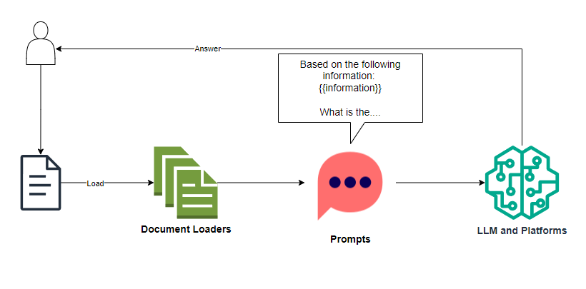
Use Case: Question-Answering with your own documents
AUGMENTED
GENERATION

Slide 16
Question
How can all my documents fit in one prompt?

Slide 17
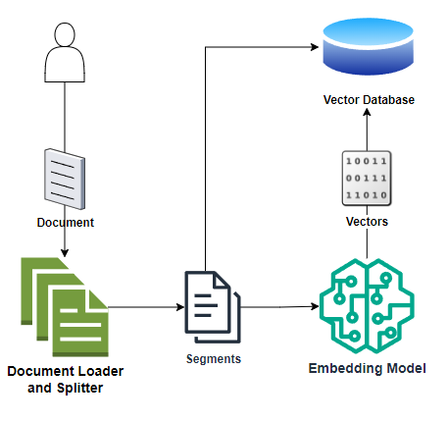
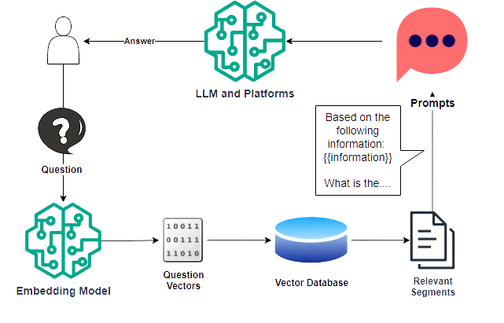
Ingestion
Retrieval
DEVELOPER
USER
RETRIEVAL AUGMENTED GENERATION (RAG)

Slide 18
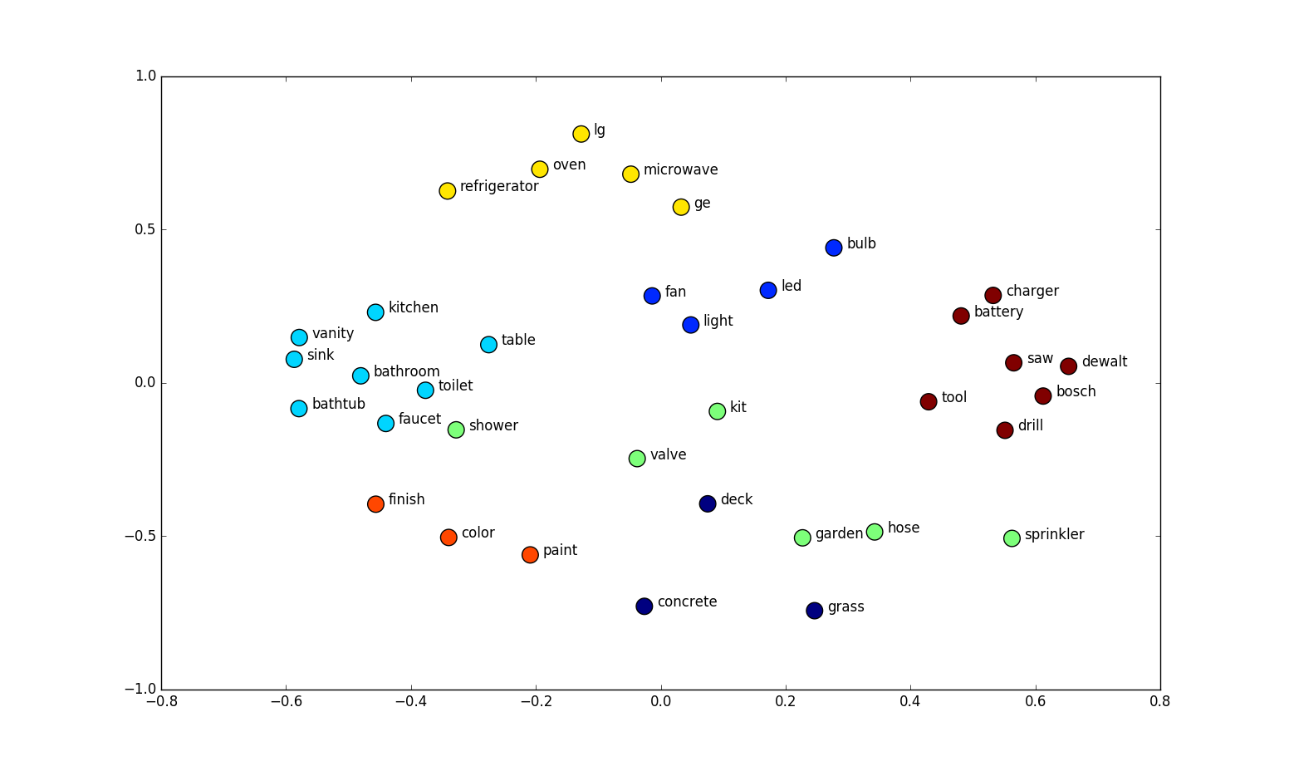
Sample Embedding Space
Taken from https://neptune.ai/blog/word-embeddings-guide

Slide 19
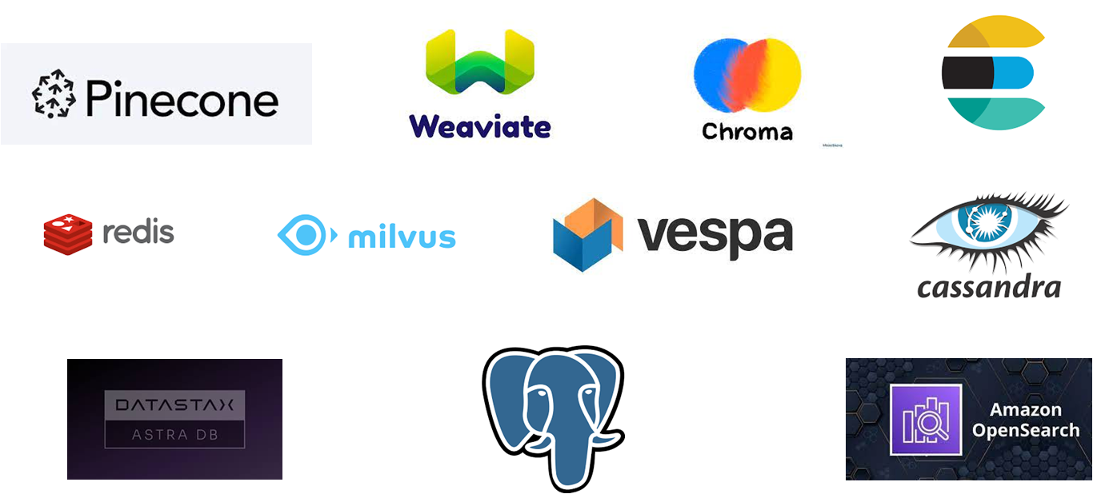
Supported Vector Stores

Slide 20

AI Services
Provide a simpler and more flexible alternative to chains
Allows you to create complex, customizable AI interactions with an interface
Data Type versatility
Declarative and Annotation-based Syntax
Can integrate with prompts, models, memory and tools.

Slide 21

Use Case: Member Extractor and Book Finder

Slide 22

AI Services Tools
Delegate your own implemented tasks to the LLM
Methods annotated with @Tool are considered tools that a language model can use.
OpenAI Function Calls

Slide 23

Use Case:
Java News Retriever

Slide 24
Other Features
Support for Java Frameworks
Spring Boot Starter
Quarkus Extension (quarkus-langchain4j-core)
Moderation models
Dynamic Tools
Streaming
Output Parsers

Slide 25
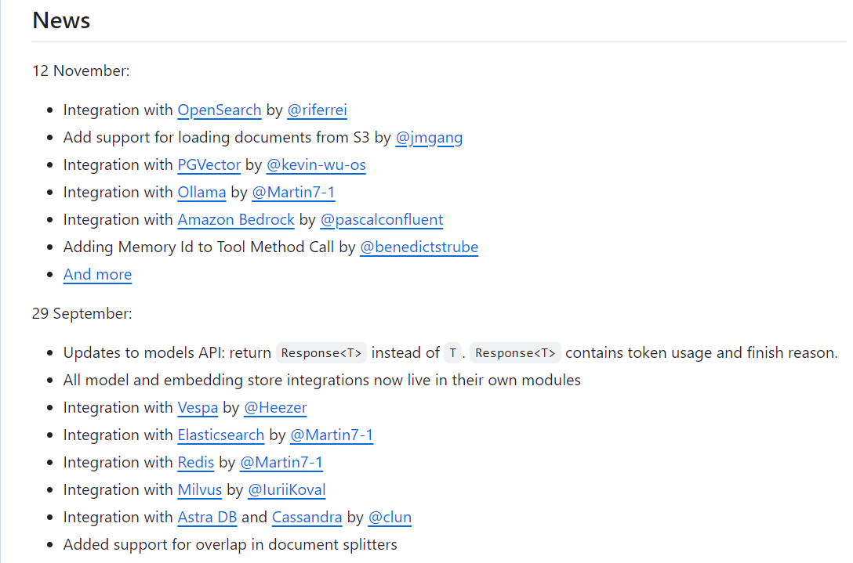
Features Coming Soon
More Vector Stores
Neo4j
MongoDB
More LLMs
More Document Loaders
Support for OpenAI Assistants API
many more

Slide 26

References
LangChain4j. (2023). LangChain4j. Retrieved from GitHub: https://github.com/langchain4j/langchain4j
Neptune AI. (2023). Word Embeddings Guide. Retrieved from Neptune AI Blog: https://github.com/langchain4j/langchain4j
Raes, L. (2023). Java Meets AI: A Hands On Guide to Building LLM Powered Applications with LangChain4j. Retrieved from YouTube: https://github.com/langchain4j/langchain4j

Slide 27

Do you have
any questions?

